Slide 1
You can’t depend on your eyes when your imagination is out of focus- Mark Twain

Slide 2
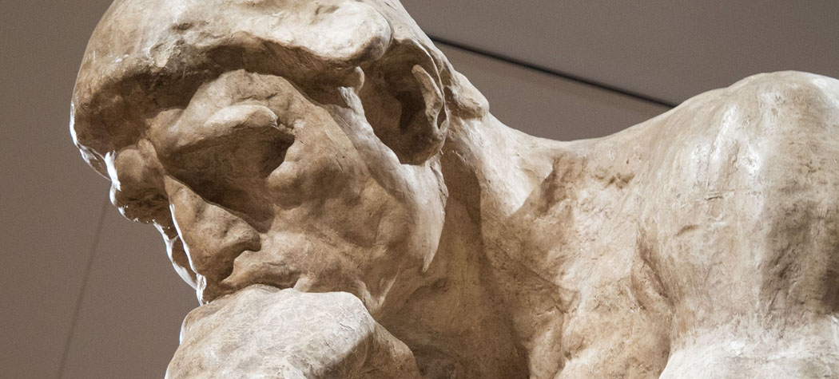

Slide 3
MINDFULNESS AND ART
Diana Taremi and Jessica Howard

Slide 4
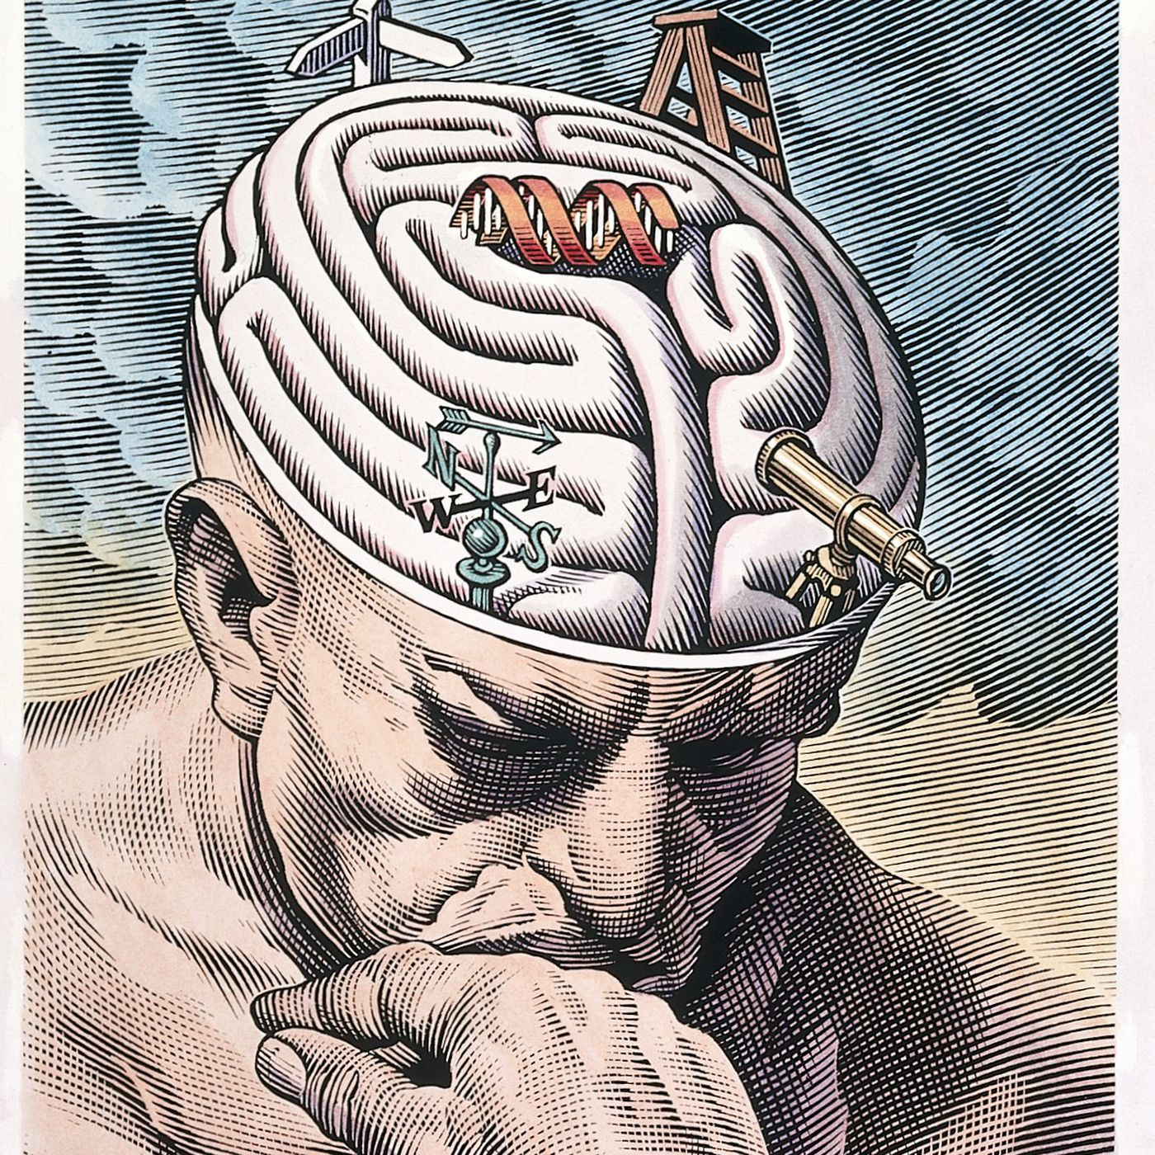

Slide 5
What is mindfulness? Mindfulness is the practice of bringing one’s attention to the present moment- our thoughts, feelings, bodily sensations, and surroundings.

Slide 6
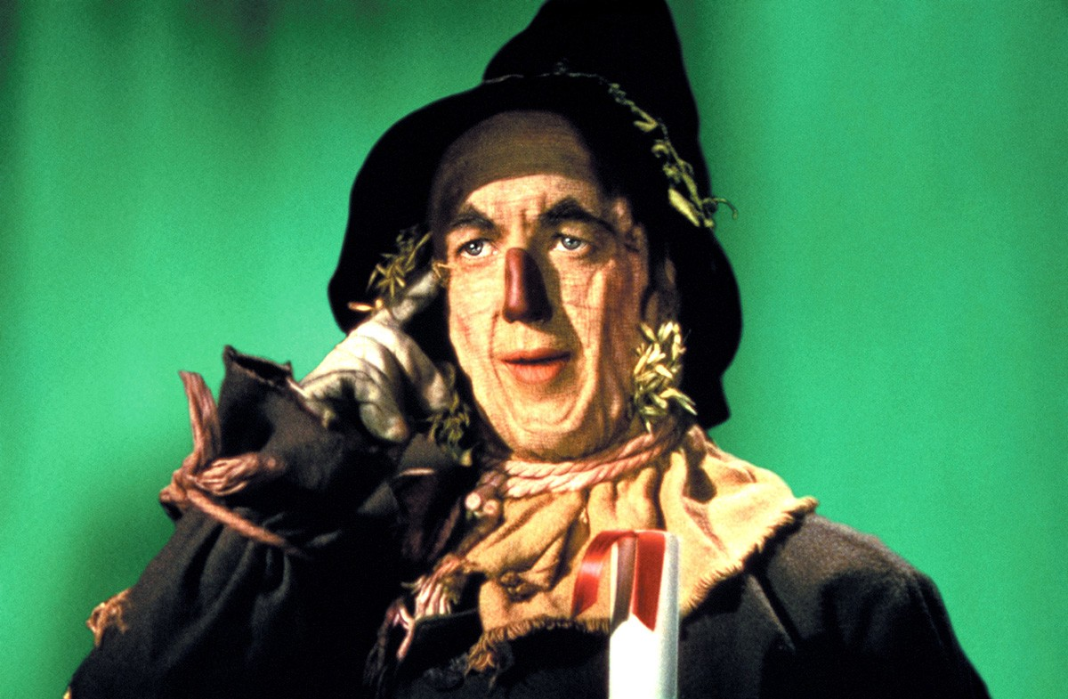

Slide 7
Mindfulness is not necessarily about the absence of thought, nor is it about brushing aside negative emotions, thoughts, or sensations. Instead, it is about drawing awareness to what’s going on internally and acting intentionally and thoughtfully in response to those stimuli.

Slide 8
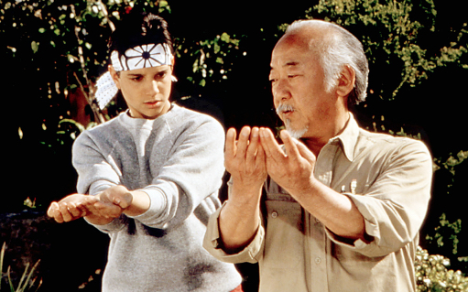

Slide 9
Art and creative practices can be naturally and instinctively mindful. Drawing, painting, and other artistic media have the power to draw us into the present moment, to bring our focus to the relationship between the pen/brush and the surface, to search for ways to convey visually what’s in our minds.

Slide 10
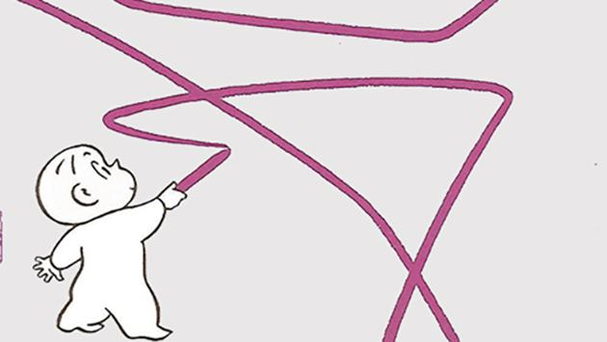

Slide 11
Creating a work of visual art requires us to turn inward, contemplate, reflect, and plan before expressing that work in the external world.

Slide 12
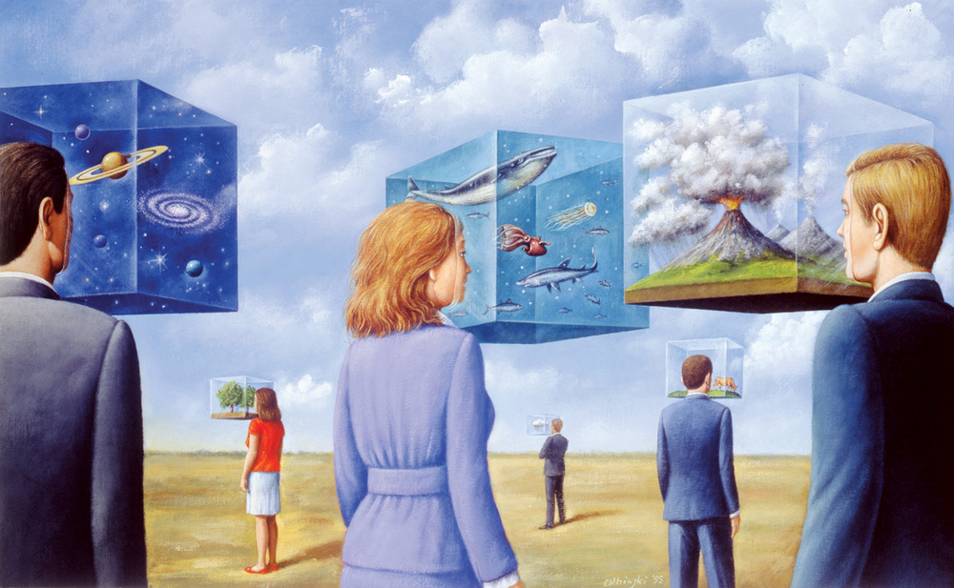

Slide 13
How do you know where to start? Try
these 3 tips for bringing more creative
mindfulness into any project, lesson or unit.

Slide 14
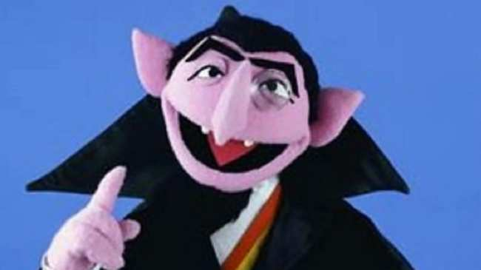

Slide 15
1. Encourage students to focus on the feeling of the pencil/brush/materials in our hands. Is the grip loose or tight? Where does the tool rest in your hand?

Slide 16
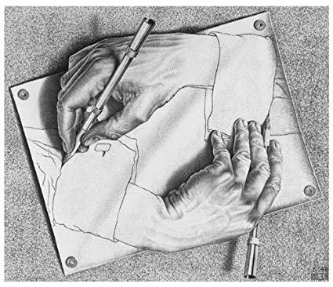

Slide 17
2. Can you bring some relaxation into the grip while still keeping control of the tool?
Urge students to notice the sensation of paint on a canvas, chalk on a piece of paper. How does it feel to connect paint to a surface? Chalk? Pencil? Crayon?

Slide 18
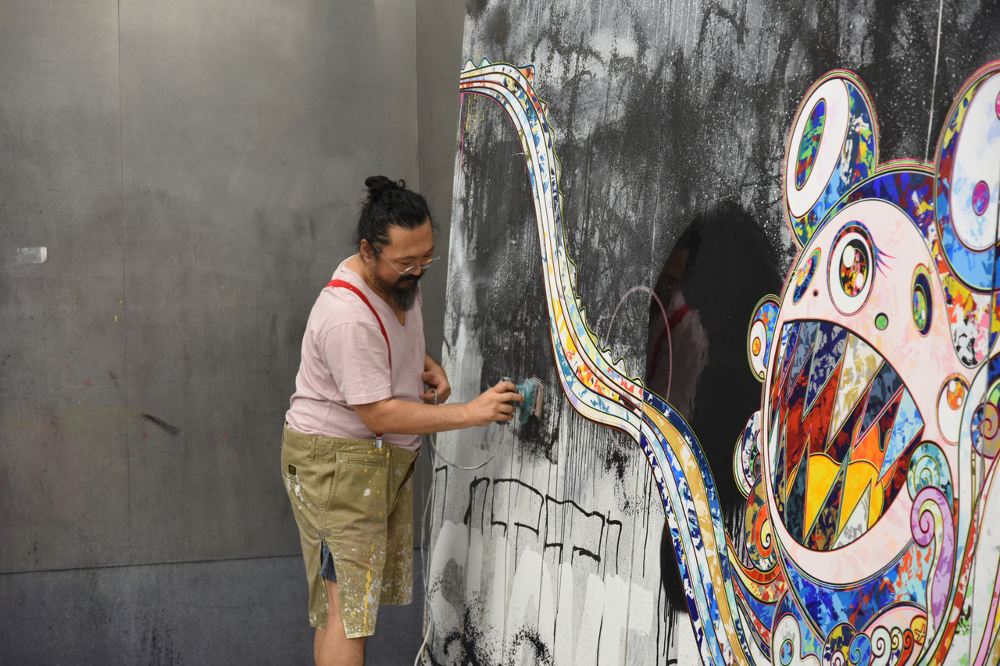

Slide 19
3. What does the surface feel like? Canvas? Paper? Mixed media? Does your hand brush the surface as you work?

Slide 20
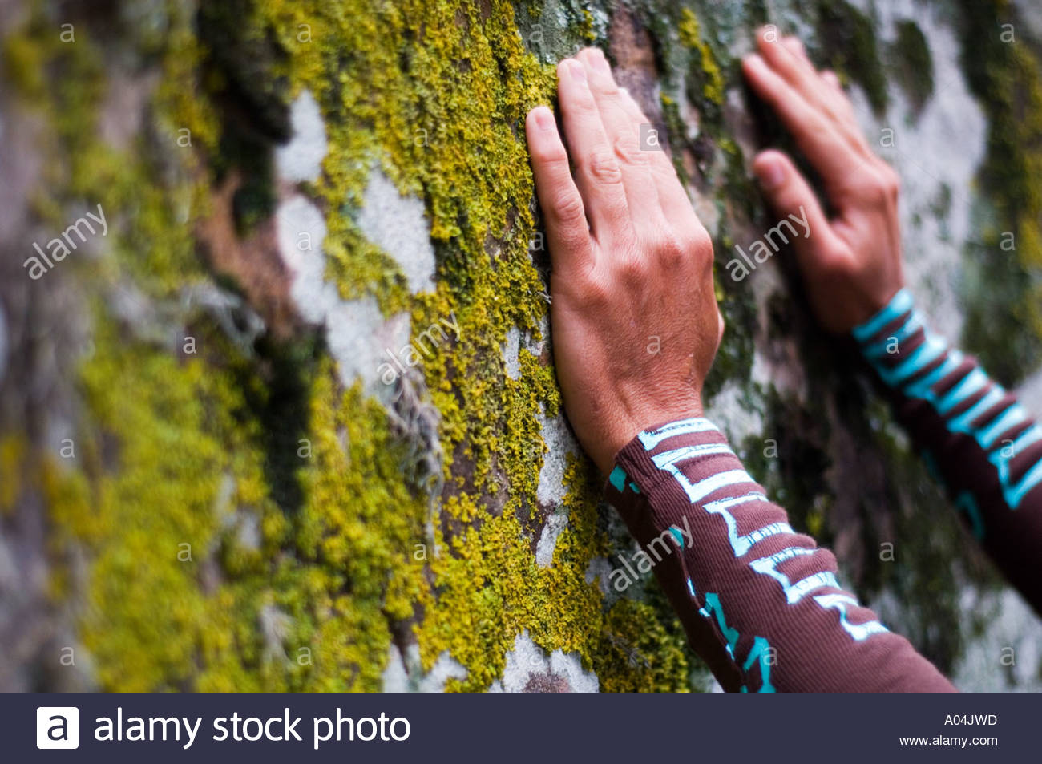

Slide 21
4. How does the rest of your body react while you work? Do your shoulders tense up? Do you clench your jaw? Do you furrow your brow? Do you hold your breath?

Slide 22
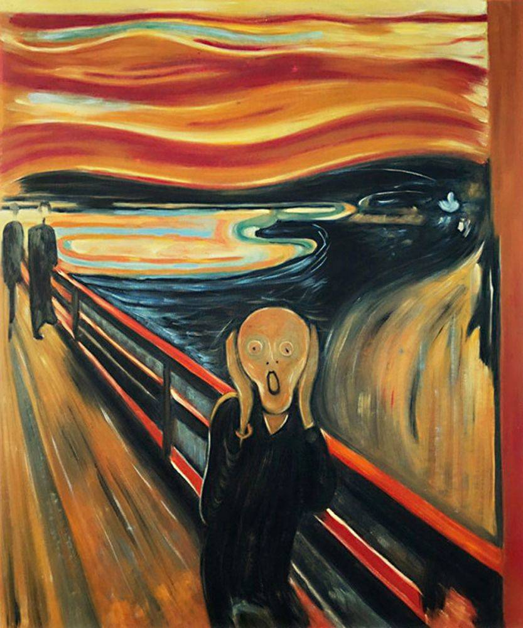

Slide 23
If you find this kind of tension creeping in, how can you begin to relax it?

Slide 24
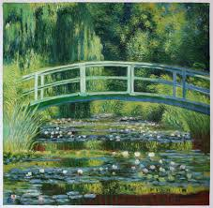
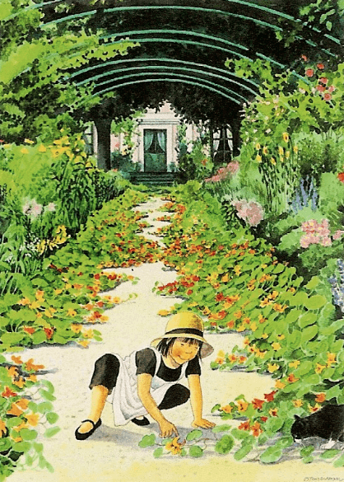

Slide 25
When we begin to bring awareness to our everyday activities, we can practice connecting with what’s going on internally and make slow, subtle shifts in how we react to our own internal stimuli.

Slide 26
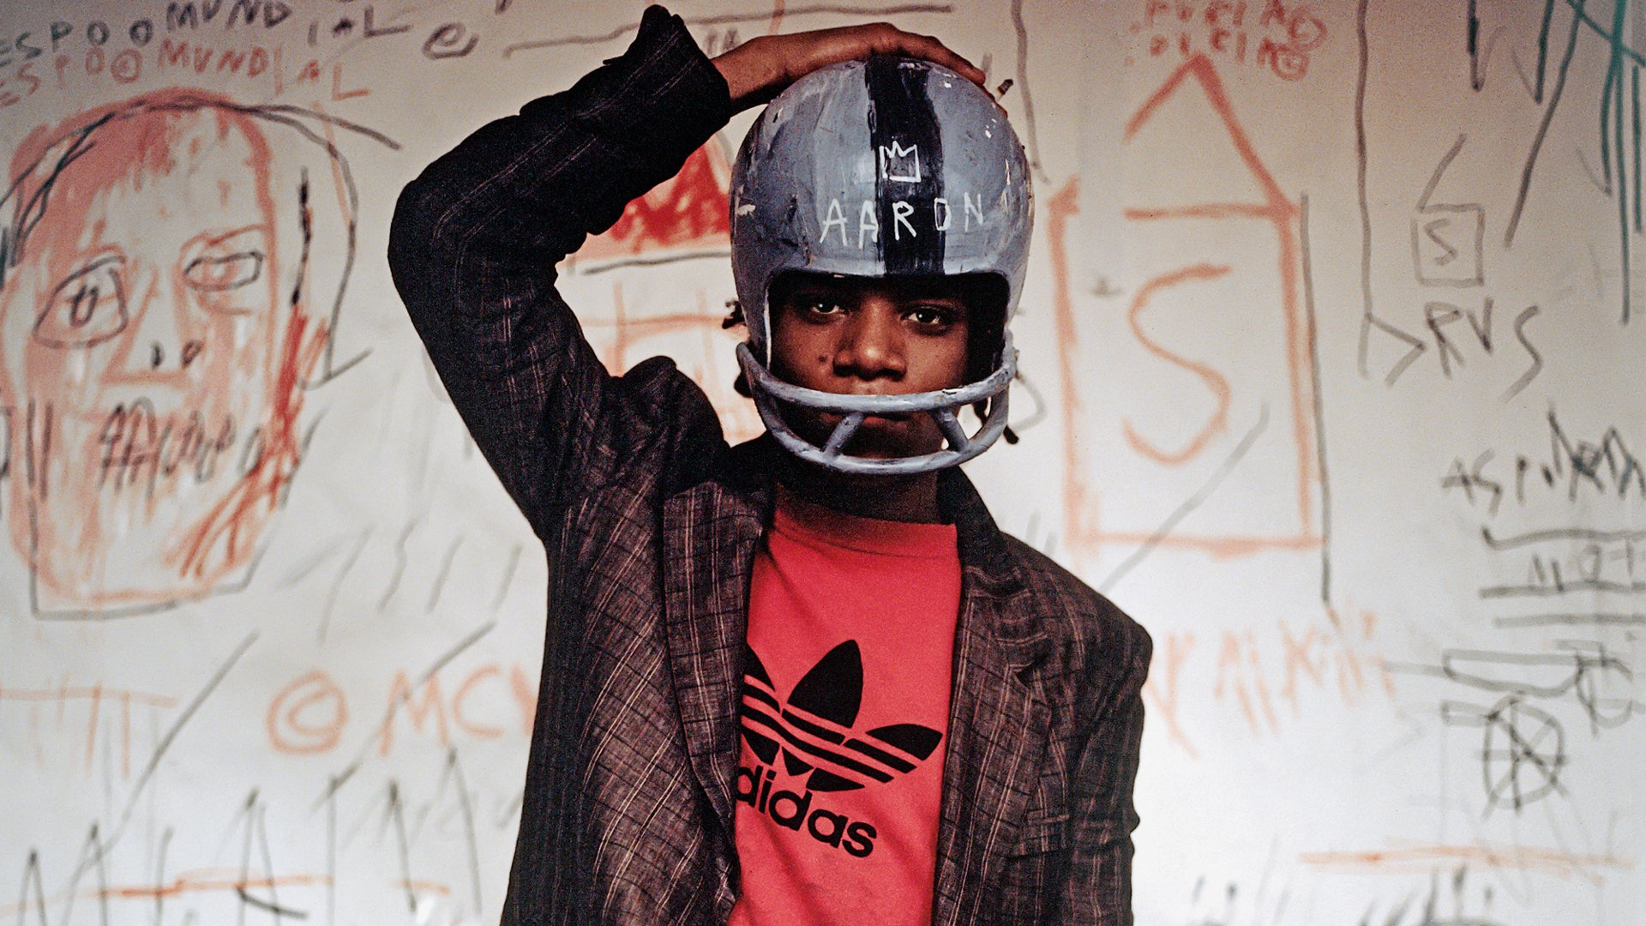

Slide 27
Visual art is such a natural place to practice this- in work that is creative, expressive, individual, and allows for reflection.

Slide 28
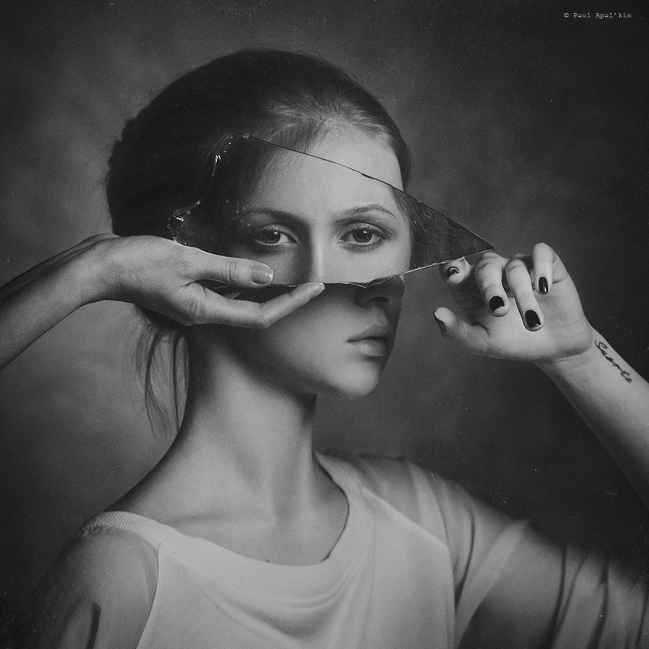

Slide 29
Questions?

Slide 30
